Slide 1


FL DCF AI COE
AI for Insurance and Regulatory
IBM Consulting
April 21, 2025
+

Slide 2
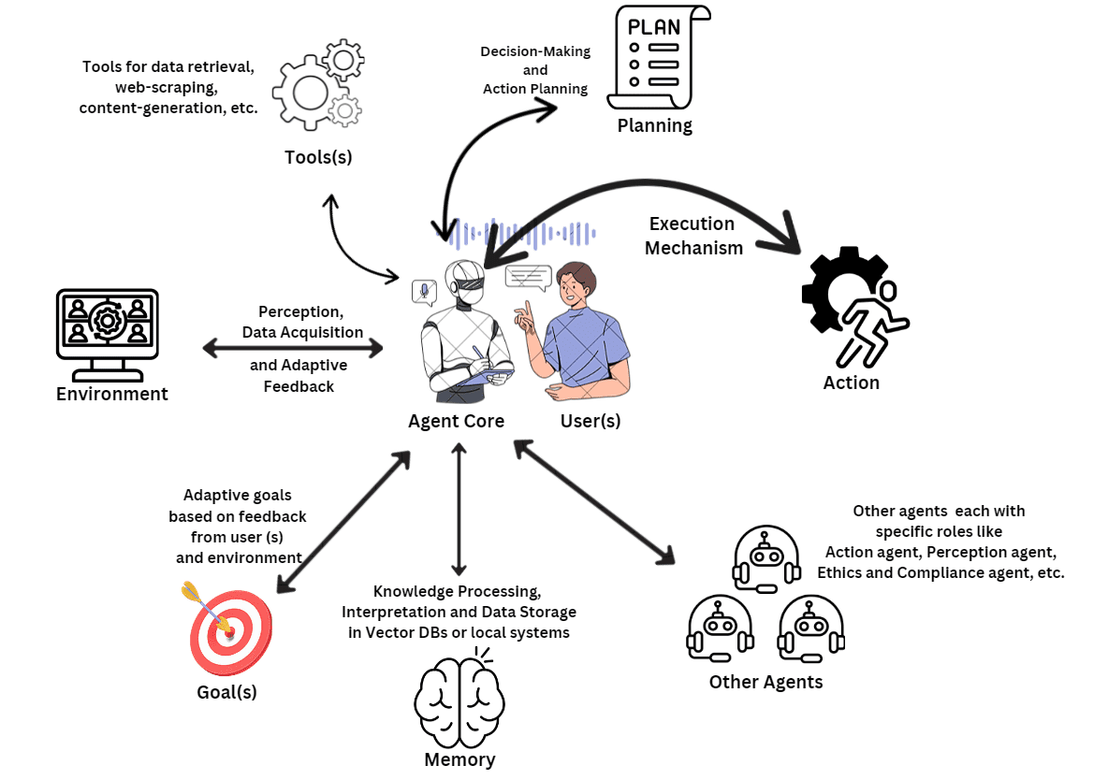
Agentic Overview
Agentic combines agents of agents and compounds AI and automation functionalities.
3 points to Successful AI Conversations
Differentiate from the “Sea of Sameness” ->“gen AI chatbot” to the right AI
Gen AI/RAG is ubiquitous and low value -> Business Led, Technology enabled
A use Case is not a solution -> An AI Journey to scale delivers value
Specialty agents

Slide 3
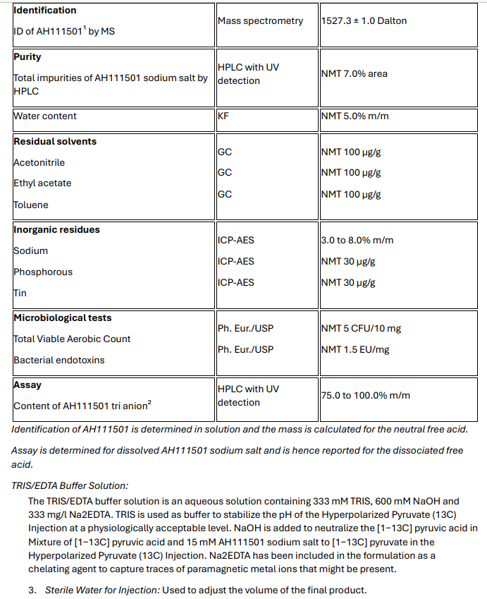
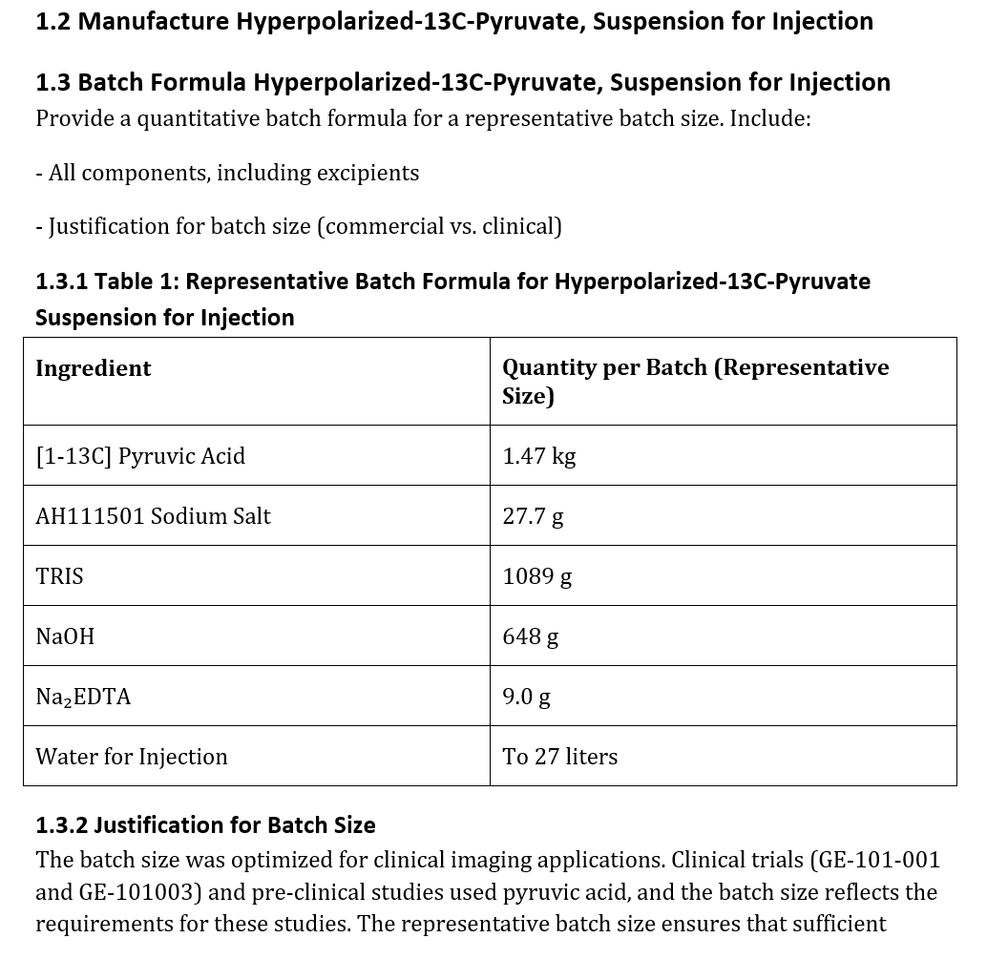
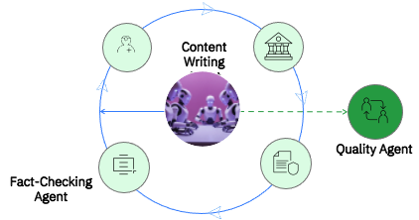
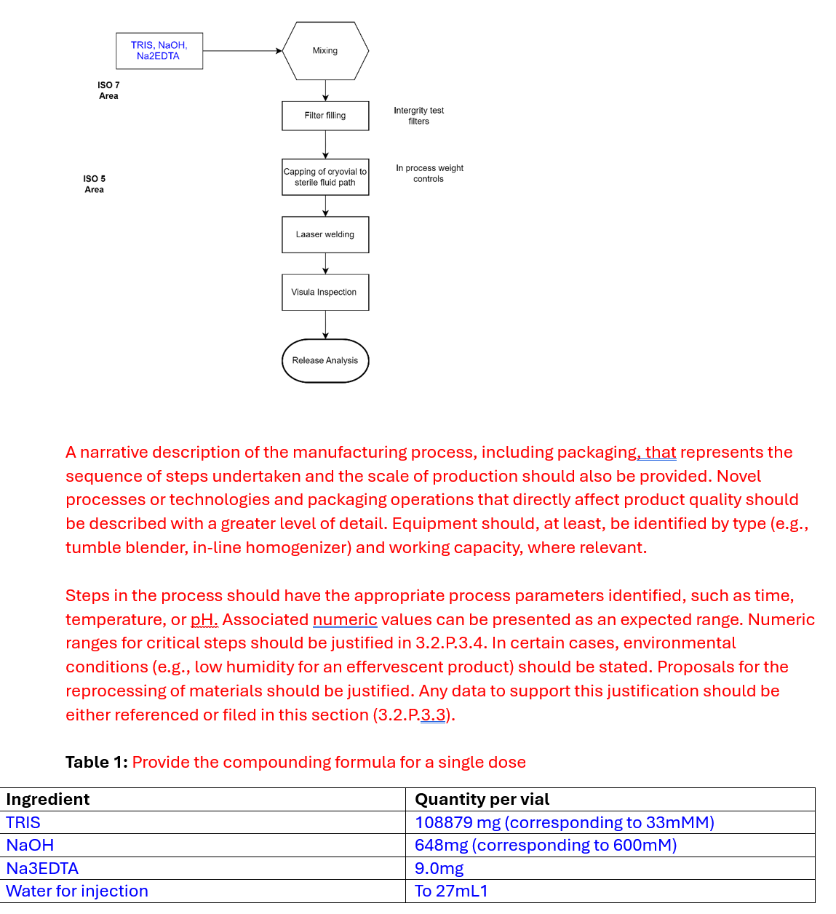
FDA Regulatory Submission reporting combines significiant amounts of clinical, safety, drug, and additional documentation and data inputs. Automation Agents Perform: 1. Evaluate inputs (documents, data, etc…) 2. Understand, evaluate, interpret content across documents + inputs 3. Respond to output requirements 4. Organize 5. Generate output
How it works
Input 1:
Output
Input 2:
Characteristics:
Numbers are calculated
Narratives are based on evaluation and interpretation of inputs

Slide 4


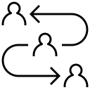




Gen AI-based Content Authoring
Take a look:
IBM is working with a Large Life Science Company to accelerate the creation of documents for regulatory submission. Using GenAI trained on company data, we have delivered a first of a kind GxP-Validated solution to automate the creation of a high-quality working draft of key sections of the regulatory submission, resulting in 50-75 % cycle time reduction, from 7-9 months to 2-3 months.
Challenge
Thousands of documents are manually written between completion of clinical trials and submission of a new drug/therapy/vaccine application to Health Authorities before they are approved for use. Regulatory submission documents require manual and time-consuming summarisation of product and process information from many data sources. This is a labour-intensive activity requiring skilled professionals.
Approach
Business Outcomes
50-75%
reduction in cycle time
70-90%
Gen AI model coverage
Furthermore, an increase in consistency, quality, and reusability of content will drive improvements in performance across the organization, driving re-use of investment
Define future state transformed process
Map data sources to eCTD document sections
Streamline workflow using GenAI and other AI/ML tooling to create content from raw data or intermediate document
Integrate the GenAI automation solution with existing regulatory systems (Veeva Vault)
Incorporate business user feedback into iterative authoring and learning.
Product
Customer Service
Supply Chain
Patient Safety
Backoffice Operations
IBM confidential

Slide 5
Take a listen:
https://ibm.ent.box.com/file/1841977336568
Yes, latency is not great. No, we do not need to tune dialog to say “pls wait…”. This is a pilot, production architecture will address latency.
Notes:
PILOT for State integrated eligibility system
Use case 1 of 12 (AI Journey)
Contains integration to backend MIS via API connections (personalized and meaningful)
Contains knowledge repository of client documents
Production architecture is contained, not public, data not being fed back to LLM
Built on Azure and Open AI
No governance oversight committee, early adopters are using common sense and being responsible
Follow on Center of Excellence (COE) proposal being delivered this week… COE is also the hot topic btw.

Slide 6
Challenge
Top 3 reasons AI fails to deliver, mirror the top 3 behaviors in the market:
1. Technology first approach
-> I want to use gen ai…
2. Strategic business misalignment
-> to…
3. Fail to scale
-> do this thing.
“My problems are my problems whether Generative AI solves them or not, help me solve my problems!”
-Hugh Hale to IBM Consulting Industry Kickoff team

